Slide 1

ColorPaint Supply Chain Project
Optimizing Global Distribution
TEAM A : Global Solutions Consulting
Anthony : Supply Chain Manager
Vishnu : Logistics Manager
Khushi : Financial Analyst
Sameer : Warehouse Manager
Lokesh : Purchasing Manager

Slide 2
Project Overview
Expand Color Paint’s Supply Chain
Grow top line revenue by 30% next year
Raise Gross Margin to 55%
Improve Inventory Turnover from 2.4 to 3.5
More efficient operations system
Build a 5-year financial plan.

Slide 3
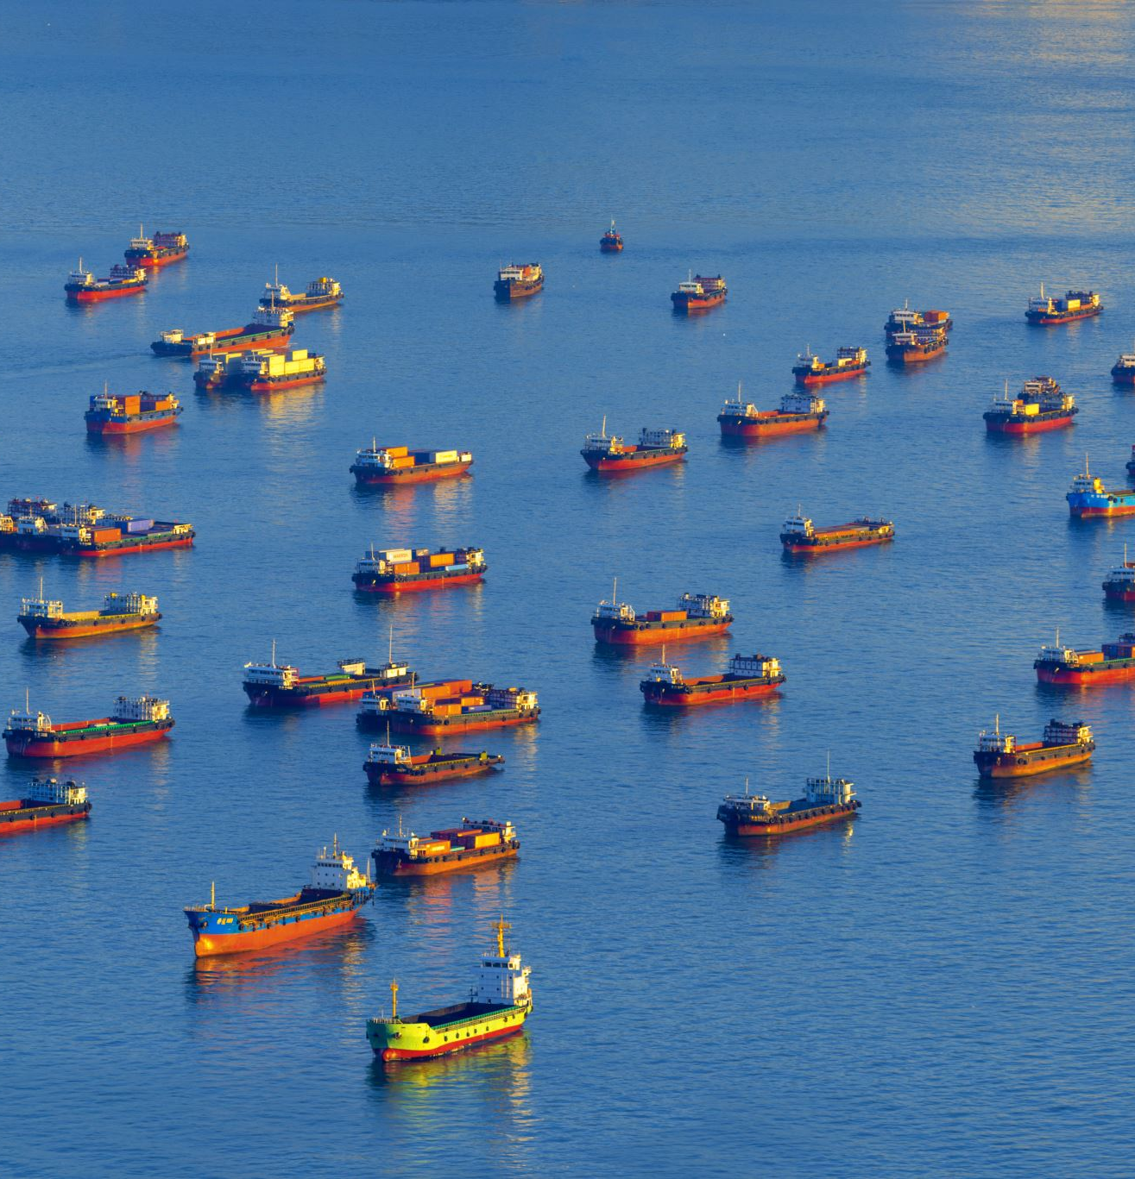
Egypt : Port Said
Geographic Advantages : Located on the Suez Canal access to Europe, Africa and Middle East
Cost Efficiency : Competitive industrial rental rates of approximately US$2.50 per m² per month, leading to manageable annual expenses. (3,000 m² for US$7,500 by month )
Government Incentives : Favorable industrial policies and potential incentives for SME expansion

Slide 4





Slide 5

ABC Analysis Overview
Vishnu : Logistics Manager

Slide 6

Financial Analysis Overview
Objective: Expand ColorPaint’s supply chain to boost revenue by 30% next year and improve margins..
Gross Margin Targets: Increase to 55%
Inventory Turnover Goal : 2.4x per year (Goal: 3.5x per year)
Challenges:
- High logistics costs due to a single warehouse.
Inefficiencies in order fulfillment : (Current: 89% reseller, 92% consumer; Goal: 95%+ and 98%).
- Manual processes leading to high labor costs and delays.
New Project : Leveraging a new warehouse in Port Said, automation, and improved logistics to reduce costs and increase efficiency

Slide 7
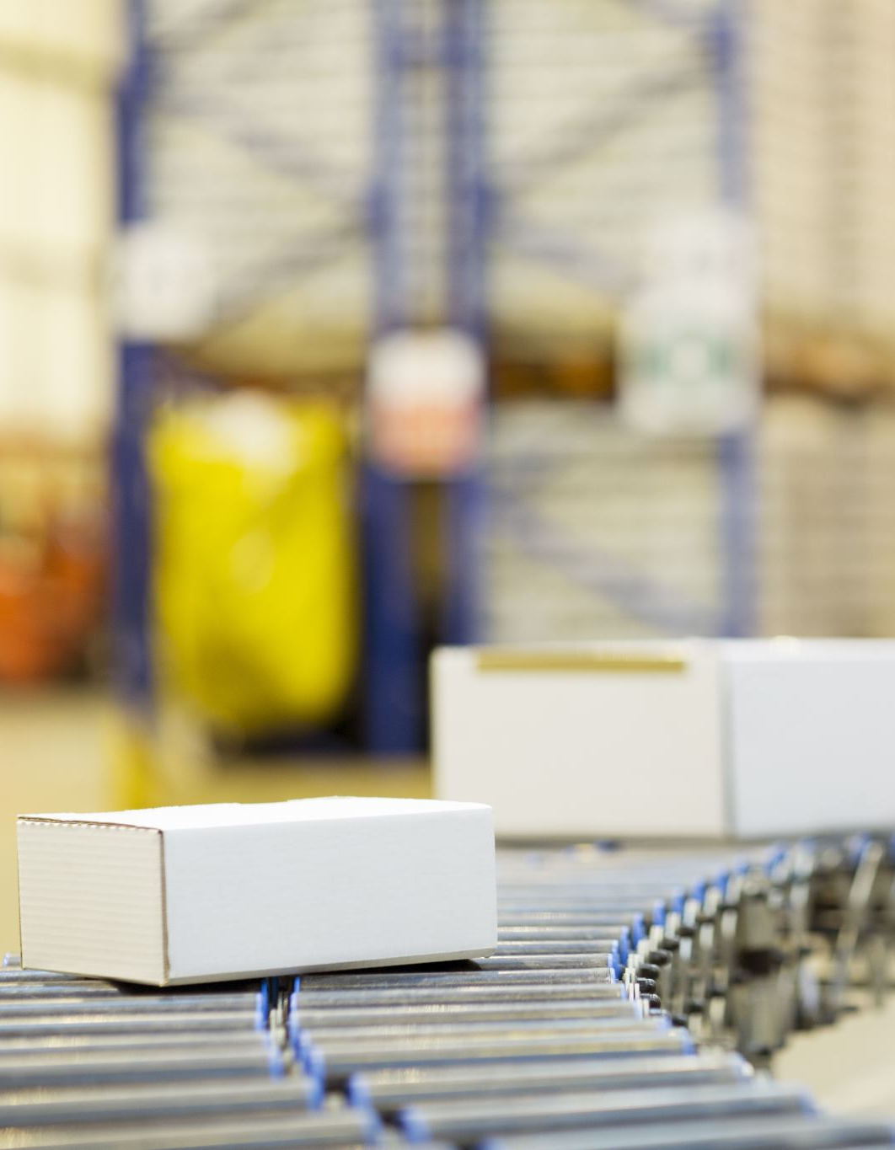
Key Financial Metrics
Current Warehouse Costs:
Industrial Rent Rates in Egypt: US$2.50 per m²/month, consider adding that for a 3,000 m² facility, monthly rent would be ~US$7,500 (~US$90,000/year).
Logistics Costs : High due to limited international reach and single location dependency.
Projected Savings :
Warehouse Management System(WMS) : Expected to reduce manual labor costs significantly
3PL Utilization : Anticipated to lower shipping costs by leveraging better rates
Revenue Enhancement :
Expanding distribution to West Coast U.S. or Europe to tap new markets (Africa and Middle East too).
Potential to drive ~30% top-line revenue growth by entering new markets
Optimized inventory turnover to free up working capital.

Slide 8


Financial Plan
Invest in Automation:
Implement barcode scanning and robotics to reduce order processing time (target 2 days )
Anticipated ROI from labor cost savings and faster fulfillment
Optimize Shipping Costs :
Negotiate contracts with carriers for hybrid shipping models
Leverage cost efficiencies from Egypt’s location and incentives
Long Term Strategy :
Build a 5- year financial plan focusing on gradual expansion and cost control
Regularly review margin %, inventory turnover, and order processing time to ensure alignment with financial goals
US$1.5M automation investment, financed at 8% over 7 years

Slide 9
Financial Analysis Overview
Metric | 2024 (Base) | Year 1 | Year 2 | Year 3 | Year 4 | Year 5
Revenue | $3,383,197 | $3,721,517 (10% ↑) | $4,093,668 (10% ↑) | $4,503,035 (10% ↑) | $5,178,490 (15% ↑) | $5,955,263 (15% ↑)
Gross Margin % | 48.50% | 50% | 52% | 54% | 55% | 55%
Gross Profit | $1,640,501 | $1,860,758 | $2,129,074 | $2,431,641 | $2,848,170 | $3,275,394
COGS | $1,742,696 | $1,860,759 | $1,964,594 | $2,071,394 | $2,330,320 | $2,679,868
Target Inventory Turnover | 2.4 | 3 | 3.5 | 4 | 4.5 | 5
Average Inventory | 726123.33 | 620253 | 561312.57 | 517848.5 | 517848.89 | 535973.6
Operating Expenses |  | $1,860,759 | $1,964,480 | $2,071,394 | $2,330,321 | $2,680,367
EBITDA |  | ($1) | $164,480 | $360,247 | $517,850 | $595,526
Depreciation Expense |  | $214,286 | $214,286 | $214,286 | $214,286 | $214,286
Annual Loan Payment |  | $288,000 | $288,000 | $288,000 | $288,000 | $288,000
Net Operating Cash Flow |  | ($502,287) | ($337,806) | ($142,039) | $15,564 | $93,240

Slide 10
Purchasing Strategy

Slide 11
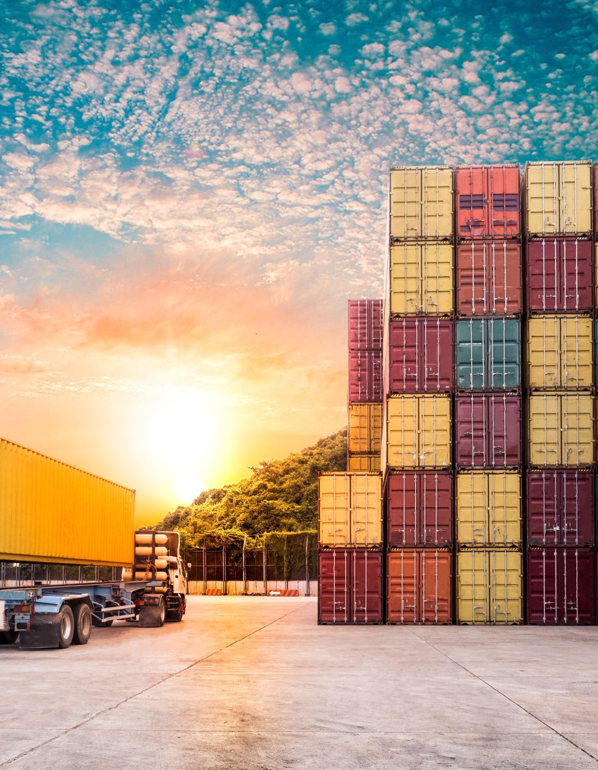
Shipping costs :
For shipping raw materials from China to Egypt it will cost $30 to $45 per cubic meter for less than container load (LCL), and $1200 to $2500 for full container load(FCL).
Same thing from US to Egypt $500 to $1000 per cubic meter for LCL and $1800 to $3000 for 20-foot FCL.
So we are opting to ship from China to Egypt, that too in bulk, so that we can use FCL and get the price down.

Slide 12
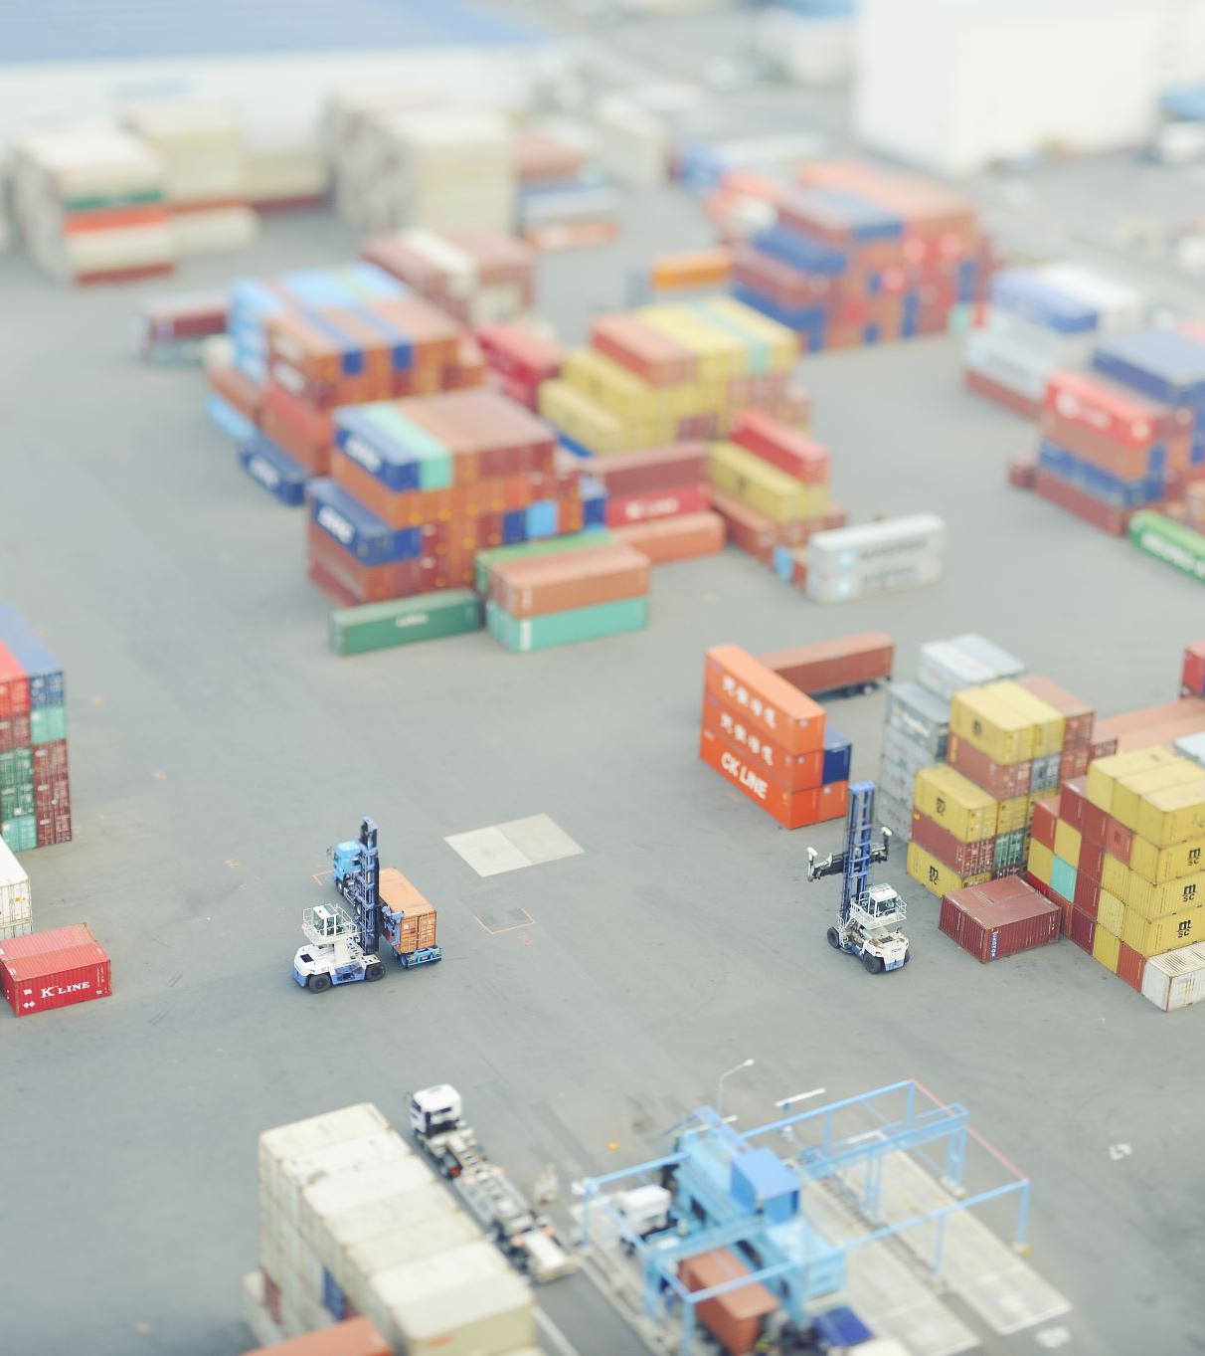
Location Advantage
Targeted business : Color Paint’s is willing to expand their business in European - African and Middle eastern market.
Egypt because they will get loan at 8% interest reducing the annual payment to around $288,000
Better connectivity through Suez canal to all major shipping lanes reducing transit times.
Cheaper raw materials shipping, quicker supplier lead times

Slide 13

Transportation
Cost Efficiency: Sea freight from China to Egypt is more economical than air freight, aligning with our budget needs.
Transit Times: Although slower than air freight, shipping from China to Egypt is still faster than from the US and remains feasible for our early operations.
We plan to ship in Full Container Loads (FCL) to reduce unit costs, as discussed earlier.
Shipping costs $30–$45/m³ or $1200–$2500 per FCL

Slide 14
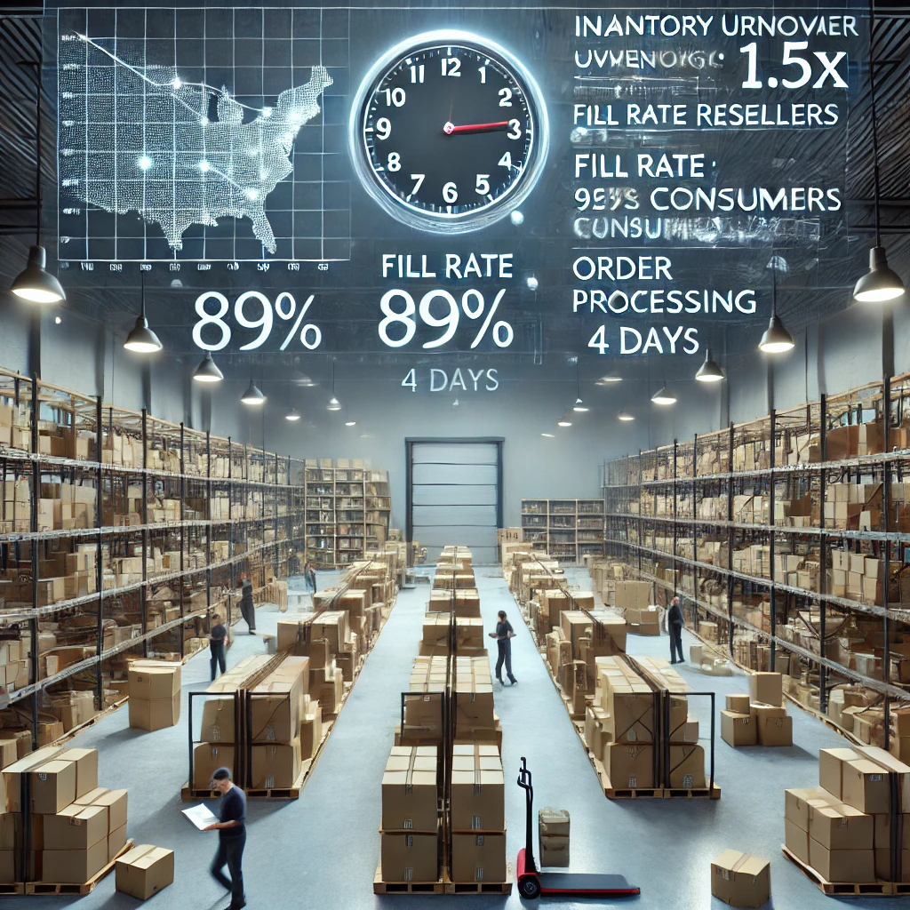
Current Warehouse Performance & Key Metrics
Location: Single warehouse in the Northeast U.S.
Distribution Regions: Servicing U.S. and European markets.
Inventory Turnover: x2.4 per year (Goal: 3.5x per year)
Order Fulfillment Efficiency:
Reseller Fill Rate: 89% (Goal: 95%+)
Consumer Fill Rate: 92% (Goal: 98%)
Order Processing Time: 4 days (Target: 2 days)
Challenges: Overstocking, warehouse layout inefficiencies, single-location dependency.

Slide 15
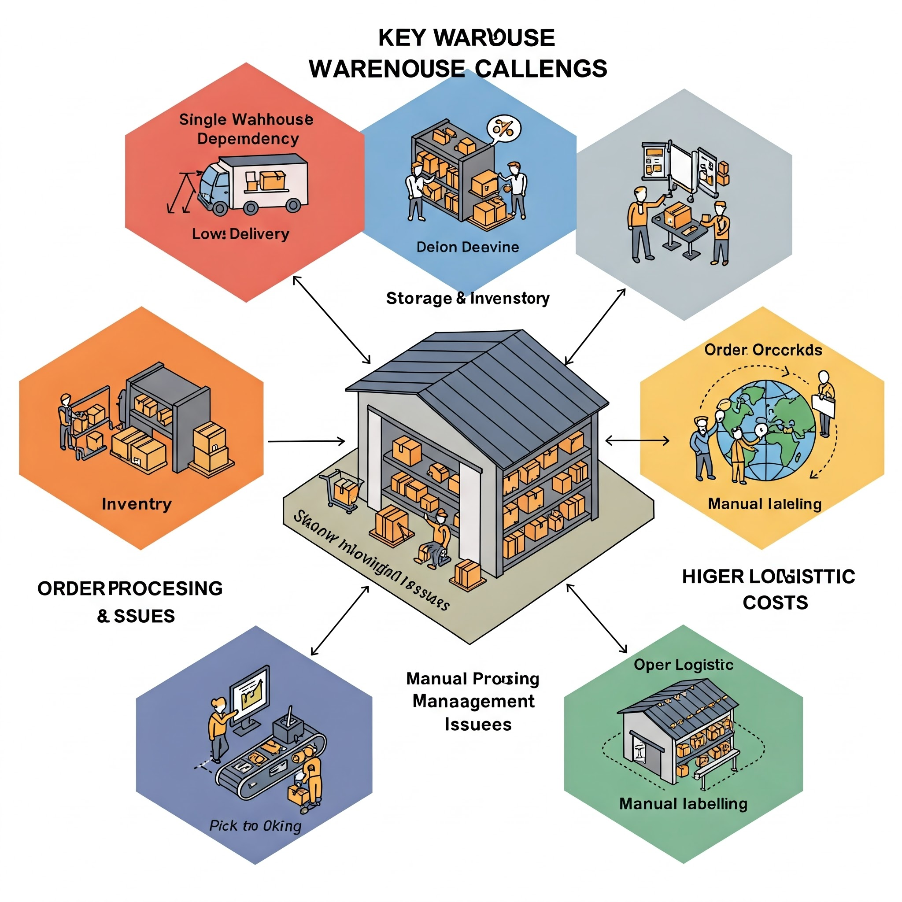
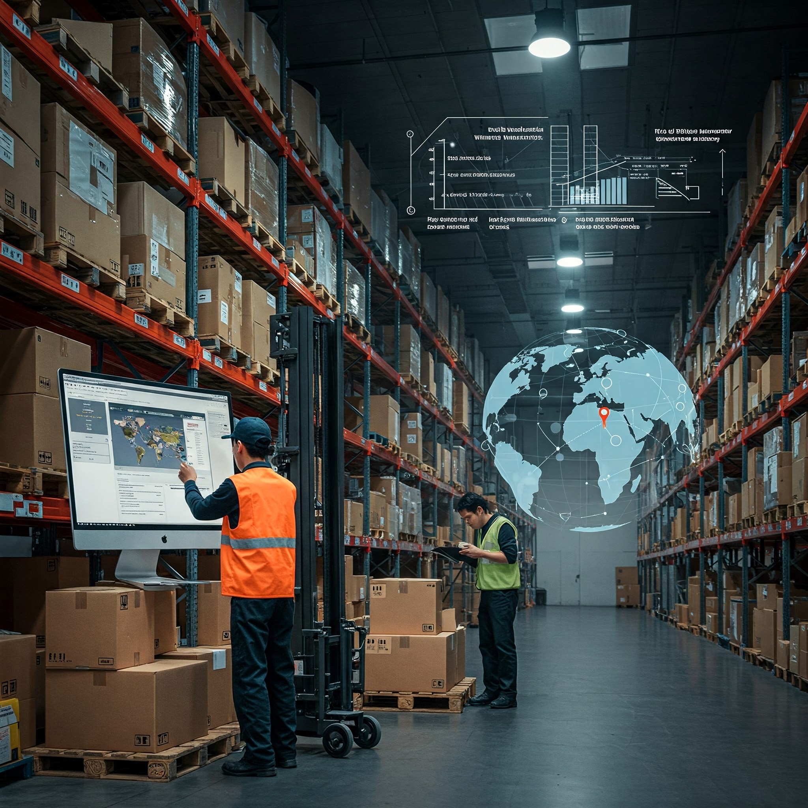
Key Warehouse Challenges

Slide 16
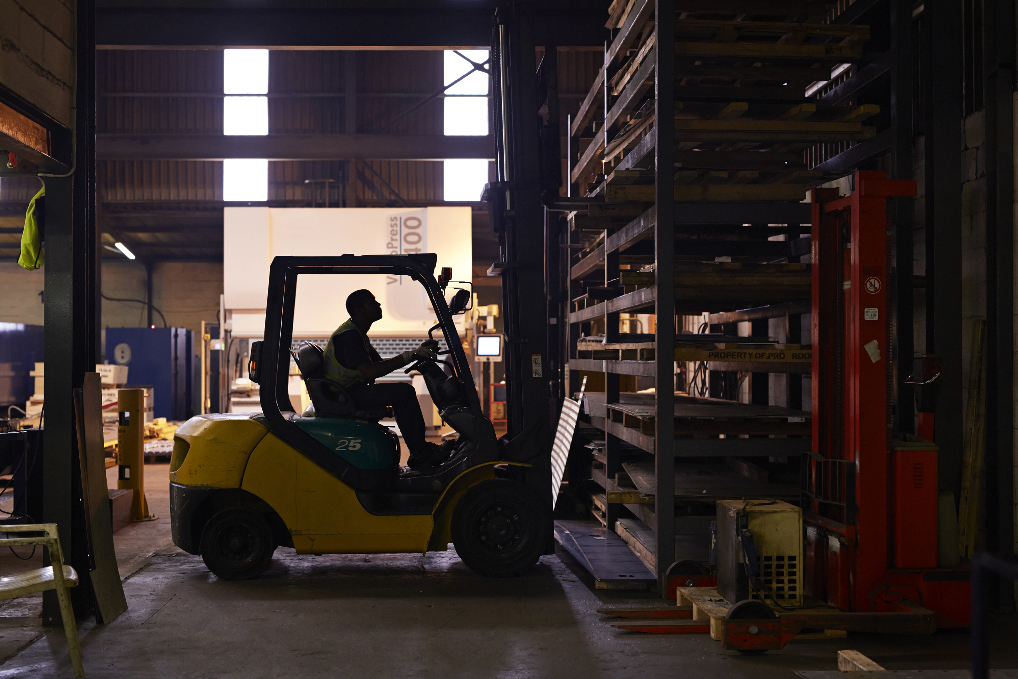
Warehouse Optimization Strategy
Key Upgrades:
Implement a Warehouse Management System :
Real-time inventory tracking and automated stock management
Integration with demand forecasting tools to reduce overstock/stockouts
Optimized Warehouse Layout :
High-bay racking to increase storage density
Dedicated pick zones for fast-moving SKUs (ABC classification)
Cross-docking for high-demand items to reduce storage time
Automation In Picking & Packing :
Barcode scanning for accurate order fulfillment
Conveyor systems or AMRs (Autonomous Mobile Robots) for faster throughput
Expected Benefits:
Reduced Order Processing Time: From 4 days to 2 days
Improved Inventory Turnover: Target 3.5×–5× (up from 3.5 goal obtained in Y3)
Lower Labor Costs & Errors: Automated workflows cut manual handling
Higher Service Levels: More accurate, faster shipments lead to higher fill rates (95%+ for resellers, 98%+ for consumers)

Slide 17
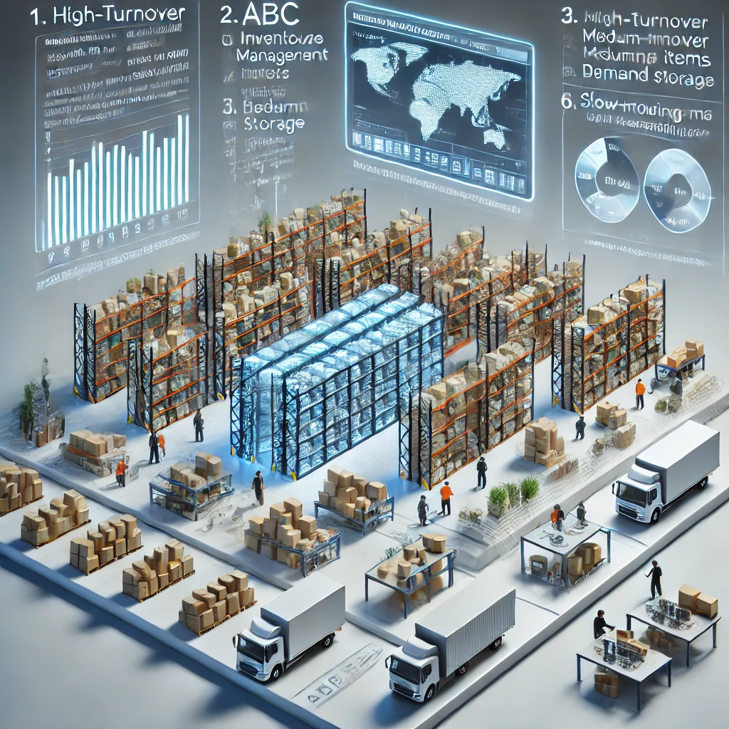
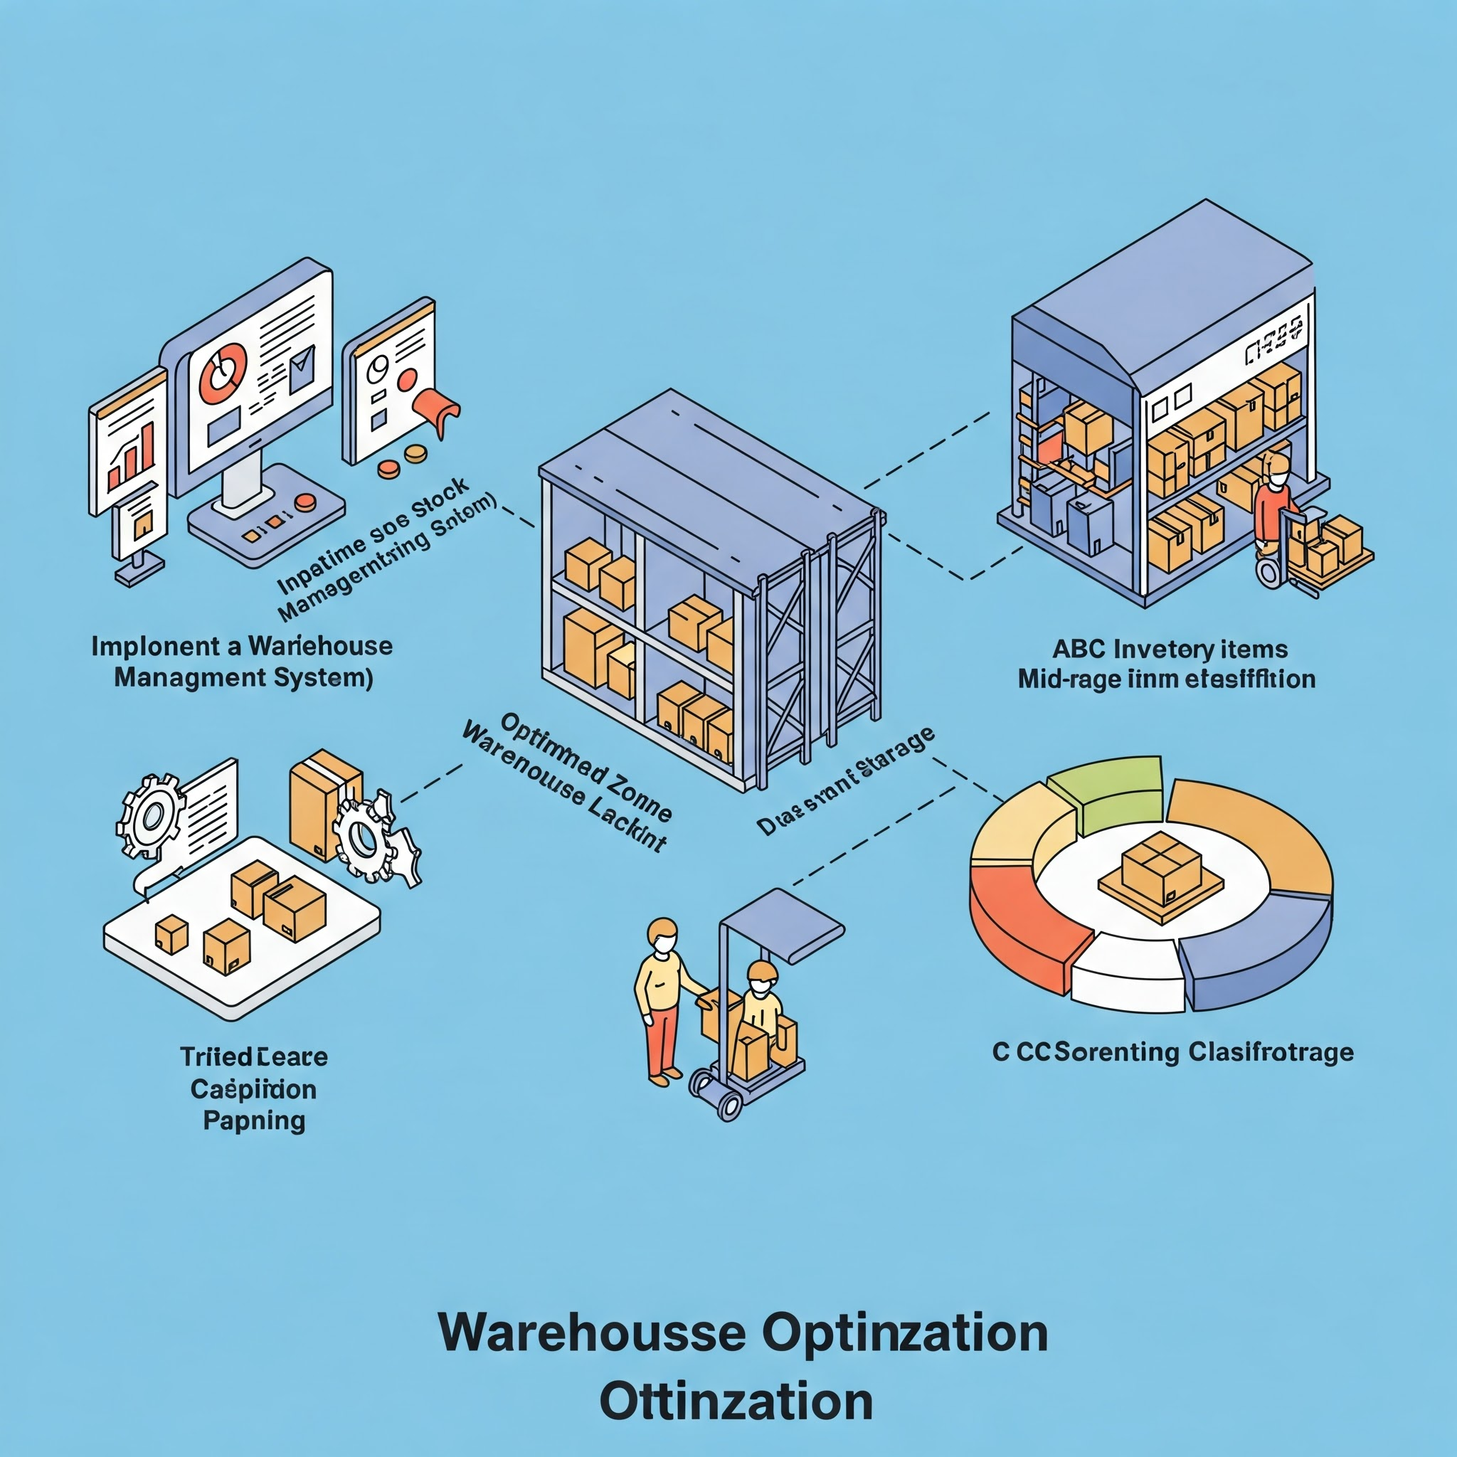
Logistics & Future Strategy
Expand Distribution Network
Evaluate a second distribution center (e.g., West Coast US or Europe) to further reduce transit times for regional customers
Use 3PL (Third-Party Logistics) Providers for cost-effective scalability and better shipping rates
Freight & Shipping Optimization
Leverage Port Said’s Location: Faster routes via the Suez Canal, enabling shorter lead times to Europe, Africa, and Middle East
Implementation Timeline :
Phase 1: 3,000 m² warehouse in Port Said, plus WMS + partial automation
Phase 2: Expansion to 5,000 m² with full automation, potential second DC/3PL integration
Expected Outcomes Achieve 30% top-line revenue growth by opening new markets
Maintain/improve gross margin toward 55%Sustain inventory turnover at or above 3.5–5×
Order Processing: Stabilize at a 2-day target
 | ABC Inventory Classification: A Category: High-turnover paints near shipping zones. B Category: Medium-turnover items in balanced storage. C Category: Slow-moving items in less accessible areas. Cross-Docking Strategy: Direct shipping for high-demand items to reduce storage time.

Slide 18
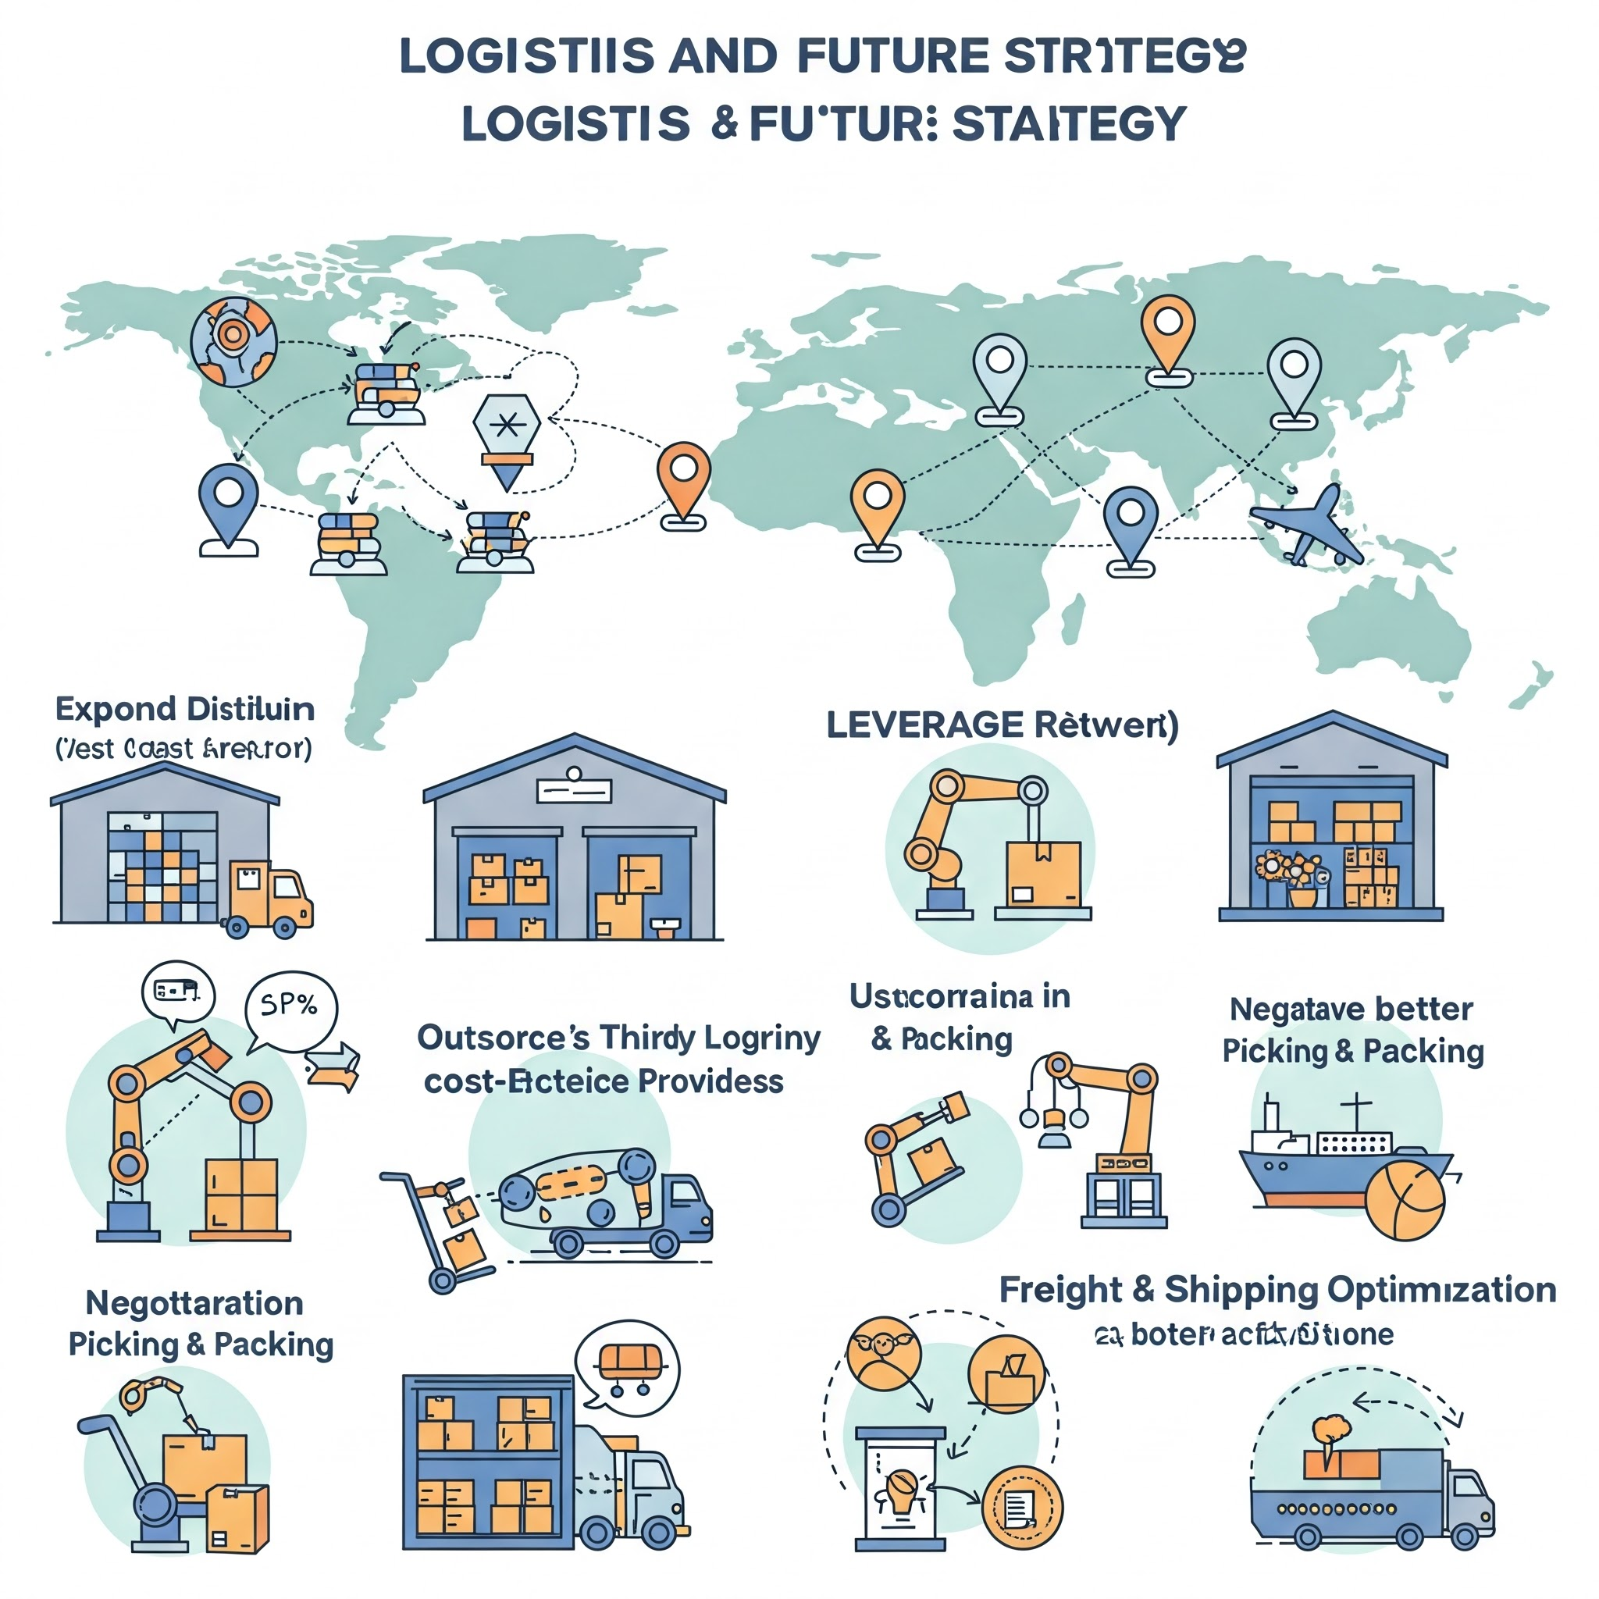

Expand Distribution Network:
Evaluate second distribution center (West Coast U.S. or Europe).
Reduce transit times and improve international fulfillment.
Leverage 3PL (Third-Party Logistics) Providers:
Outsource warehousing for cost-effective scalability.
Utilize 3PL expertise for better shipping rates.
Automation in Picking & Packing:
Use robotics and conveyor systems to speed up fulfillment.
Implement barcode scanning for faster order accuracy.
Freight & Shipping Optimization:
Negotiate better contracts with carriers.
Introduce hybrid shipping models (air, sea, ground) for cost efficiency.

Slide 19
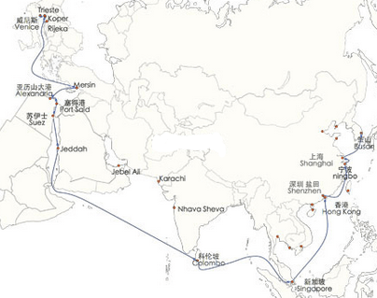
Shipping to Port Said

Slide 20
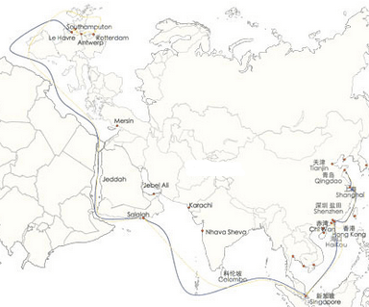
Shipping to Europe

Slide 21


